Slide 1
Malignant comments classifier project
Submitted by:
Rohit Kattewar

Slide 2
Introduction
In the times of great expansion of the social media, more and more number of people join different social media platforms and make their virtual presence visible by sharing their opinions and other form of information.
The social media debates may arise due to differences in opinion and may often result in fights over the social media during which offensive language termed as malignant comments may be used from one side.
This clearly pose the threat of abuse and harassment online.
As such, some people stop giving their opinions or give up seeking different opinions which result in unhealthy and biased discussion.

Slide 3
Problem Statement And Understanding
The proliferation of social media enables people to express their opinions widely online. However, at the same time, this has resulted in the emergence of conflict and hate, making online environments uninviting for users. Although researchers have found that hate is a problem across multiple platforms, there is a lack of models for online hate detection.
Online hate, described as abusive language, aggression, cyberbullying, hatefulness and many others has been identified as a major threat on online social media platforms. Social media platforms are the most prominent grounds for such toxic behavior.
There has been a remarkable increase in the cases of cyberbullying and trolls on various social media platforms. Many celebrities and influences are facing backlashes from people and have to come across hateful and offensive comments. This can take a toll on anyone and affect them mentally leading to depression, mental illness, self-hatred and suicidal thoughts.
Internet comments are bastions of hatred and vitriol. While online anonymity has provided a new outlet for aggression and hate speech, machine learning can be used to fight it. The problem we sought to solve was the tagging of internet comments that are aggressive towards other users. This means that insults to third parties such as celebrities will be tagged as unoffensive, but “u are an idiot” is clearly offensive.
Our goal is to build a prototype of online hate and abuse comment classifier which can used to classify hate and offensive comments so that it can be controlled and restricted from spreading hatred and cyberbullying.

Slide 4
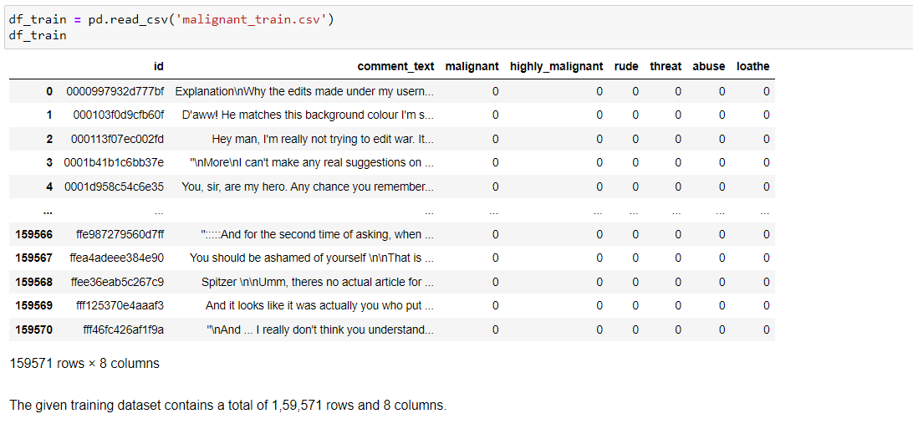
Dataset: Train dataset

Slide 5
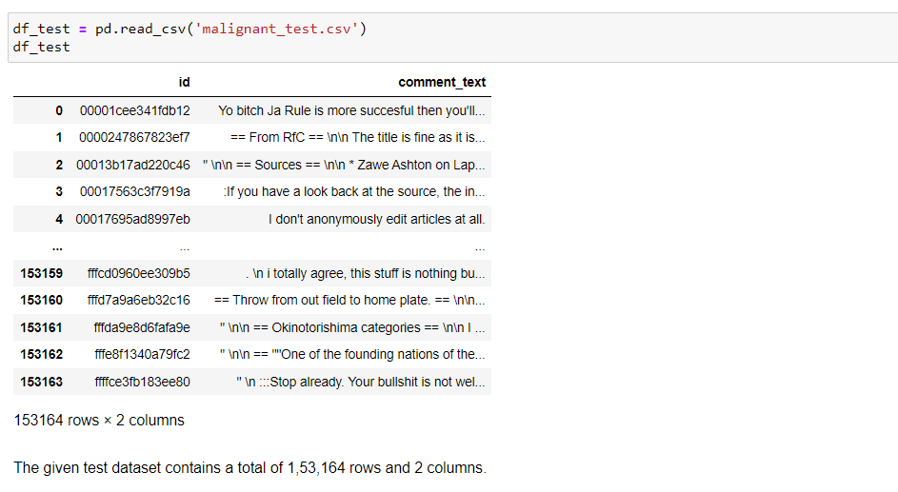
Dataset: Test dataset

Slide 6
Exploratory data analysis
1. Univariate Analysis: Univariate analysis is the simplest form of analyzing data. “Uni” means “one”, so in other words your data has only one variable.
2. Multivariate Analysis: Multivariate analysis is a set of statistical techniques used for analysis of data that contain more than one variable.
3. Correlation of Dataset: Correlation is used to test relationships between quantitative variables or categorical variables.
4. Correlation with Target variable: Correlation with the target variable to know how the data is related.
5. Conclusion: Summary with the conclusion of all the analysis

Slide 7
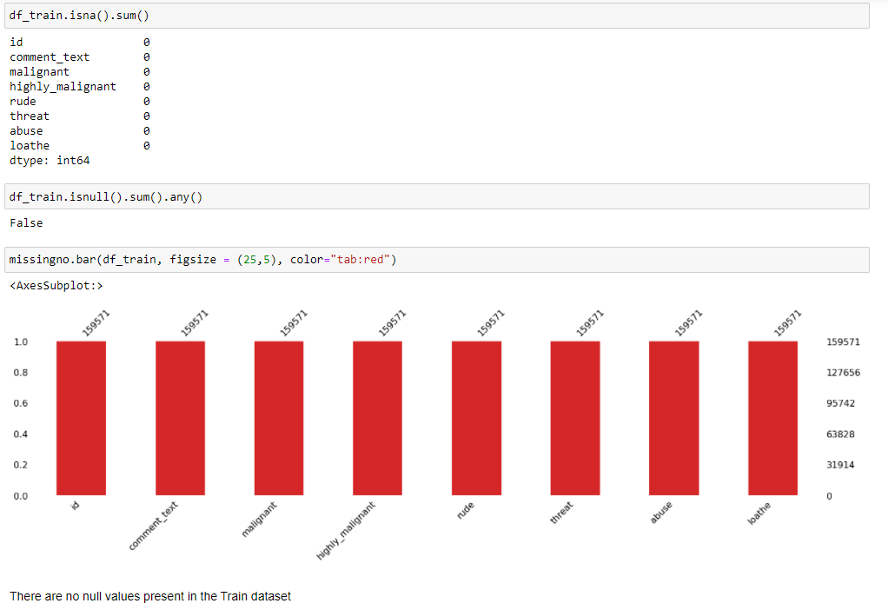
Exploratory data analysis

Slide 8
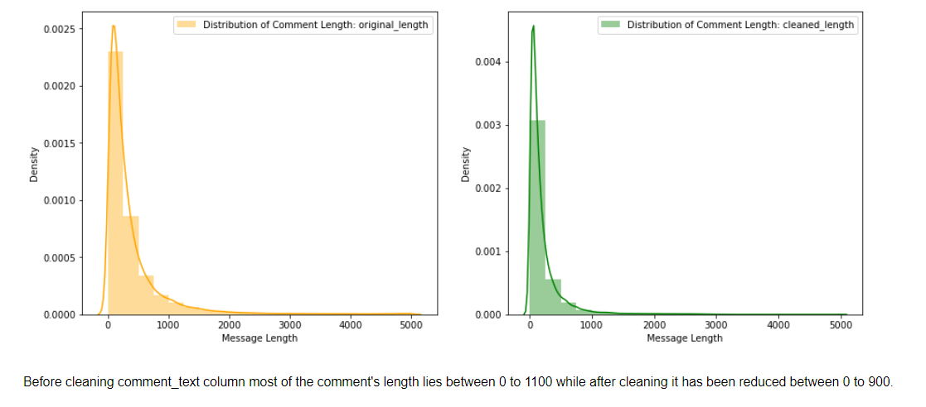
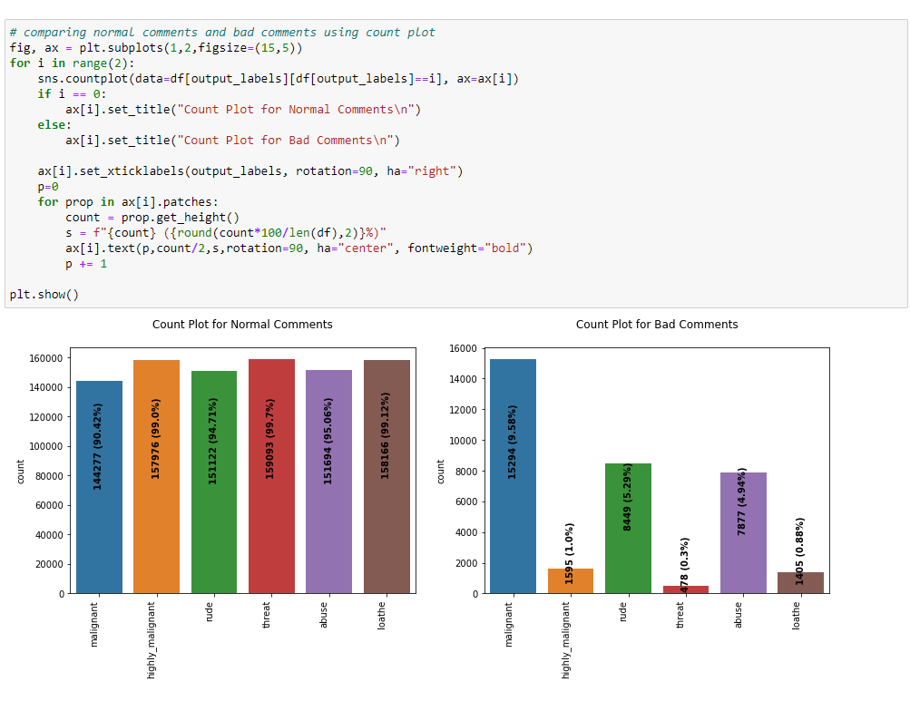
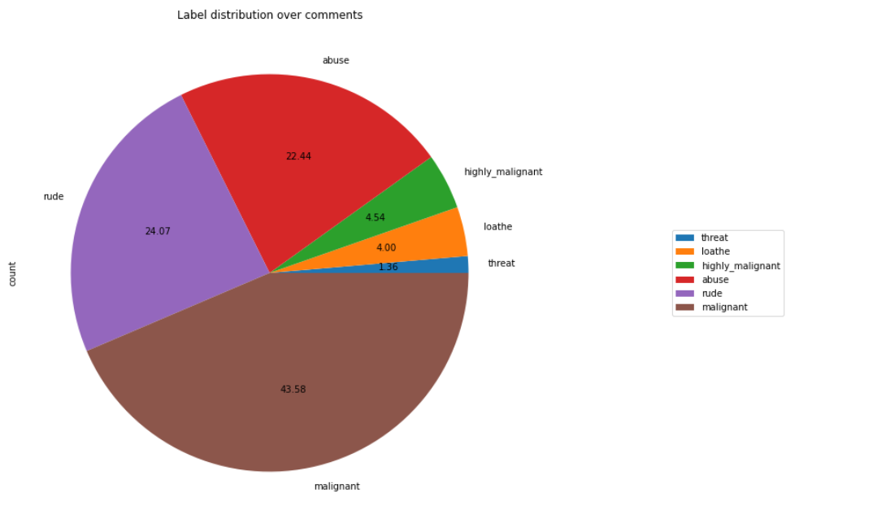
Exploratory data analysis

Slide 9
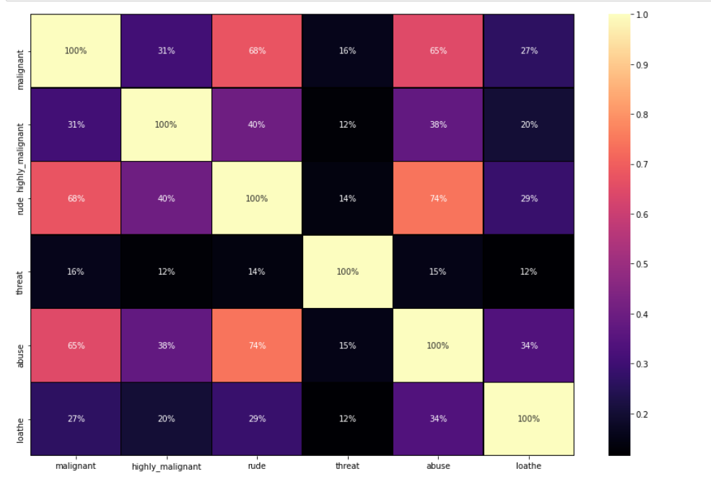
Exploratory data analysis

Slide 10
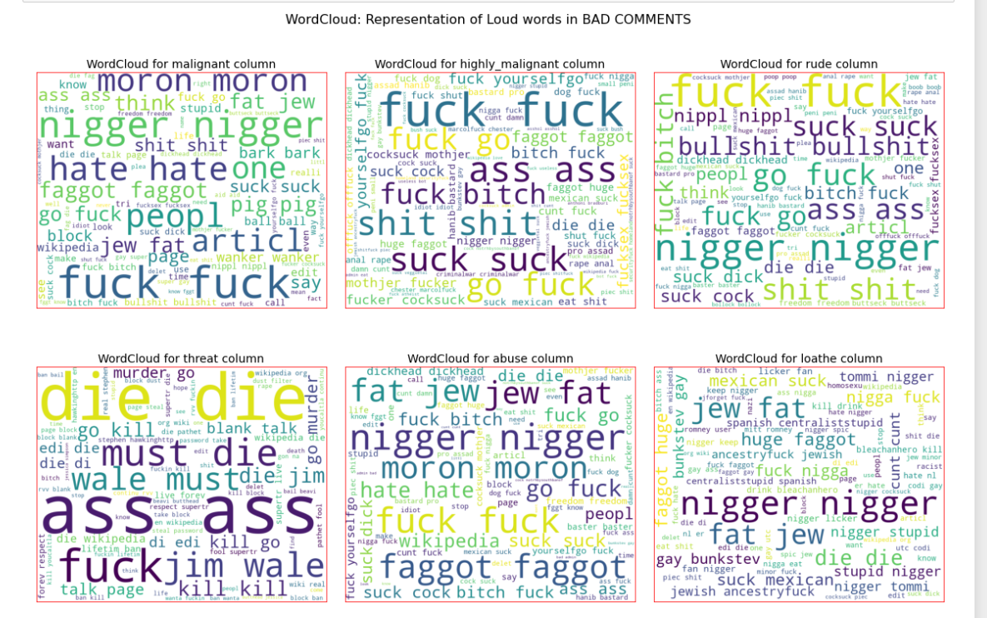
Wordcloud:

Slide 11
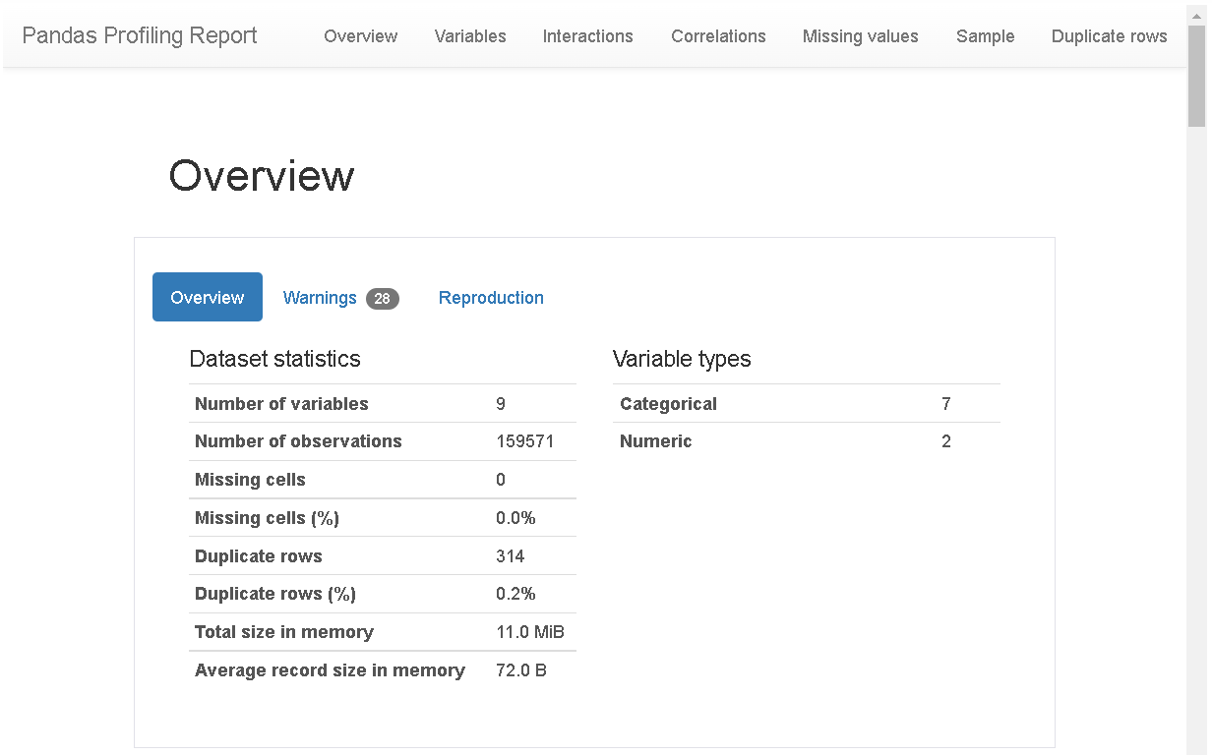
Pandas profiling:

Slide 12
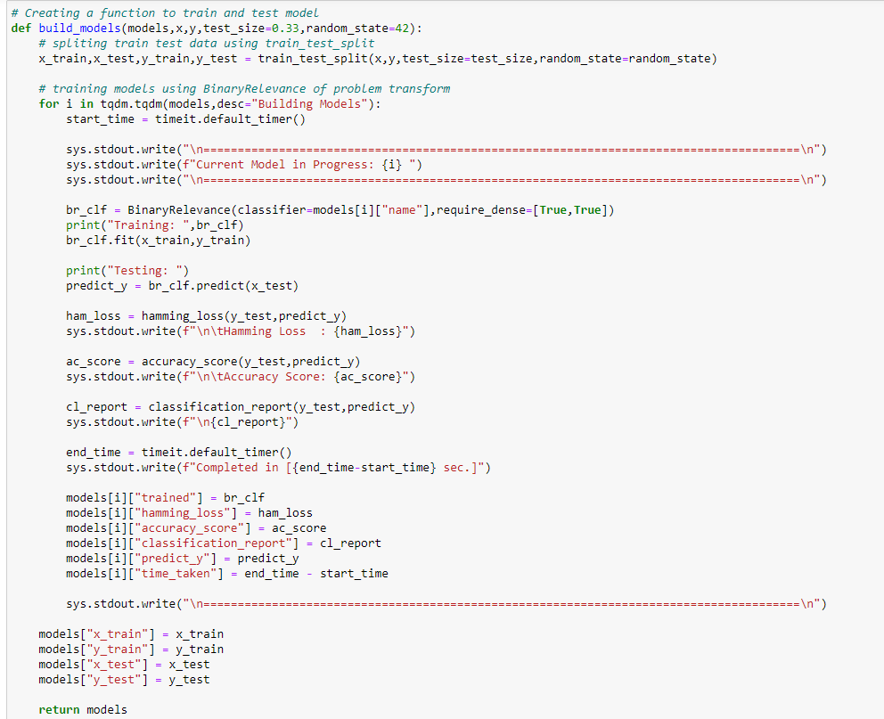
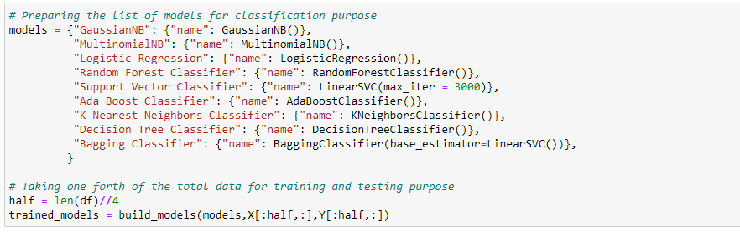
Model Building:

Slide 13
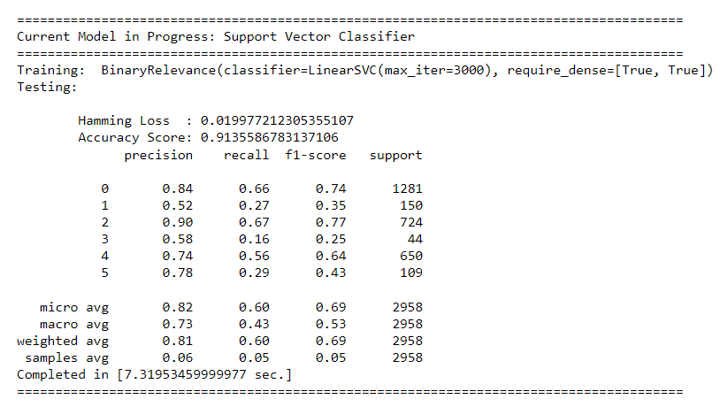
Model building:

Slide 14
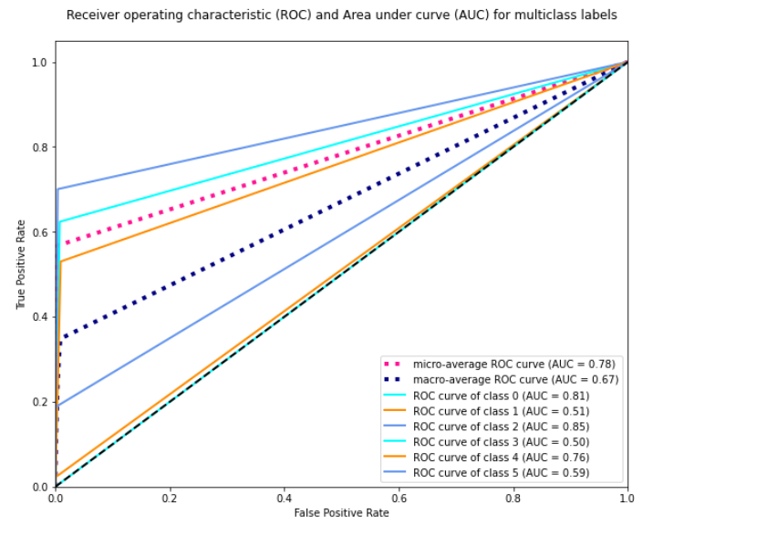
Auc-roc curve:

Slide 15
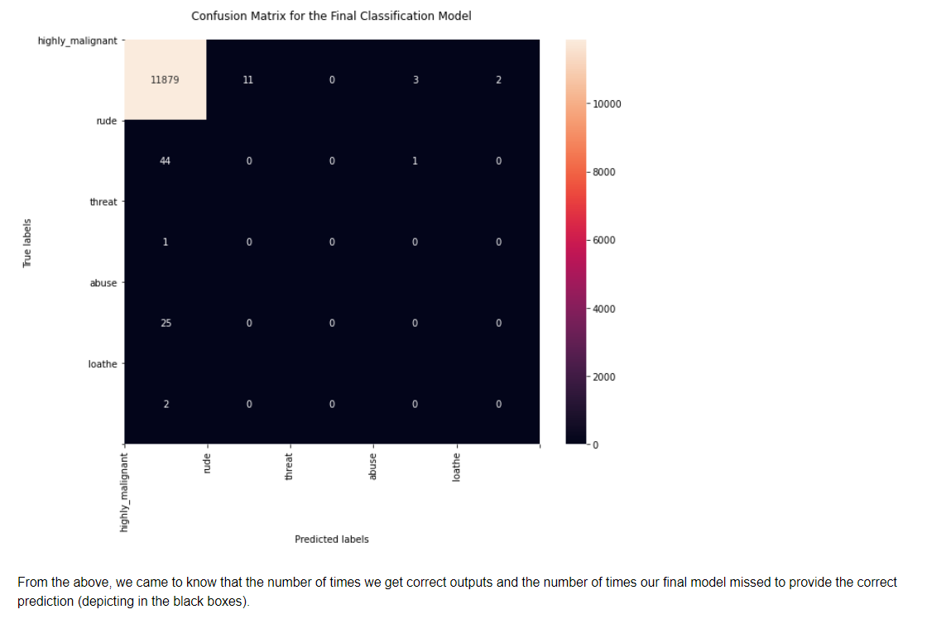
Confusion metrix:

Slide 16
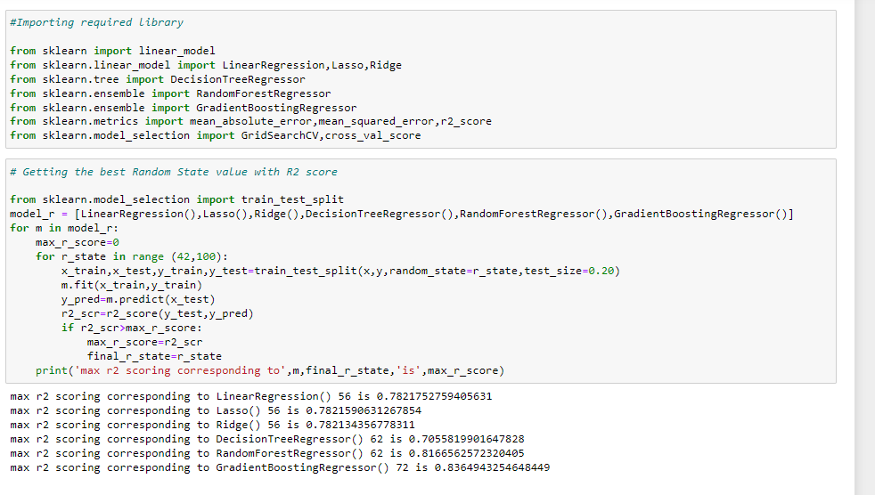
Model building
GradientBoostingRegressor has the best performance metrics with a good R2 score. So, we chose GradientBoostingRegressor as the finalized model.

Slide 17
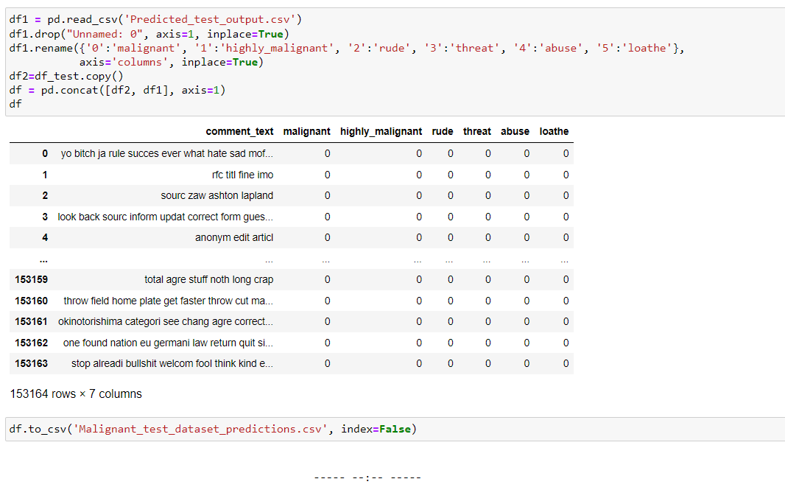
Predicted values

Slide 18
conclusion
In process of making a model which can classify the malignant comments, we were able to learn various Natural language processing techniques like lemmatization, stemming, removal of stop words. We were also able to learn to convert strings into vectors through hash vectorizer. In this project we applied different evaluation metrics like log loss, hamming loss besides accuracy.
The finding of the study is that only few users over online use unparliamentary language.
And most of these sentences have more stop words and are being quite long.
As discussed before few motivated disrespectful crowds use these foul languages in the online forum to bully the people around and to stop them from doing these things that they are not supposed to do.
Our study helps the online forums and social media to induce a ban to profanity or usage of profanity over these forums.

